Slide 1
Data Wrangling
Data Wrangling: Clean, Transform,
Merge, Reshape

Slide 2
Combining and Merging Data Sets
Data contained in pandas objects can be combined together in a number of built-in ways.

Slide 3
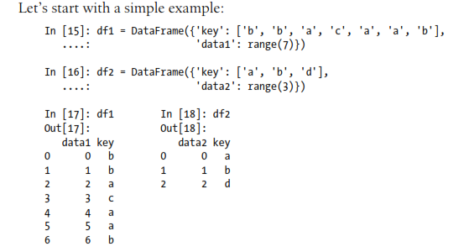
Database-style DataFrame Merges

Slide 4
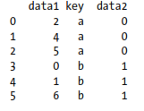
Database-style DataFrame Merges
This is an example of a many-to-one merge situation

Slide 5
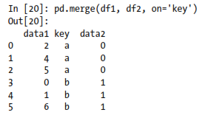
Database-style DataFrame Merges
Note that I didn’t specify which column to join on. If not specified, merge uses the overlapping column names as the keys. It’s a good practice to specify explicitly, though:

Slide 6
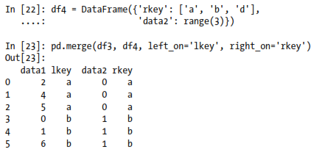
Database-style DataFrame Merges
If the column names are different in each object, you can specify them separately:

Slide 7
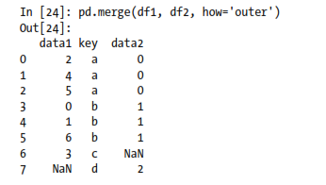
Database-style DataFrame Merges
Outer join:

Slide 8
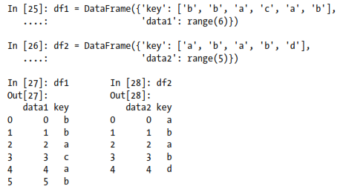
Database-style DataFrame Merges
Many-to-many merges:

Slide 9
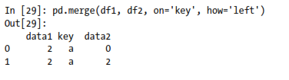
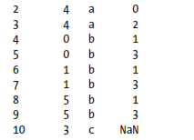
Database-style DataFrame Merges
Many-to-many merges:

Slide 10
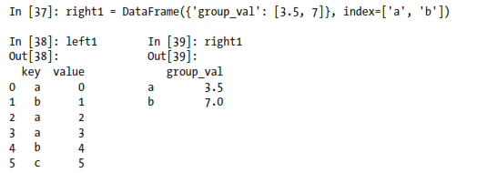
Merging on Index
In some cases, the merge key or keys in a DataFrame will be found in its index.
In this case, you can pass left_index=True or right_index=True (or both) to indicate that the index should be used as the merge key:

Slide 11
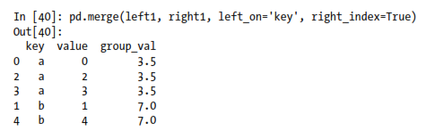
Merging on Index

Slide 12
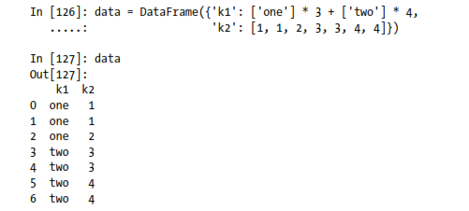
Data Transformation
Removing Duplicates

Slide 13
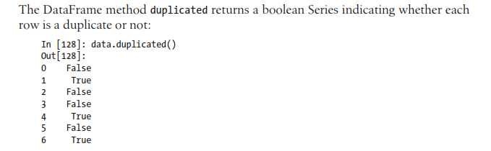
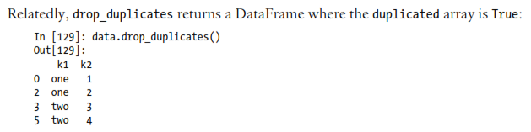
Data Transformation

Slide 14
Transforming Data Using a Function or Mapping
For many data sets, you may wish to perform some transformation based on the values in an array, Series, or column in a DataFrame.
Consider the following hypothetical data collected about some kinds of meat:
data = DataFrame({'food': ['Pastrami', 'corned beef', ‘lamb’,
‘chicken', 'pastrami', 'mutton', ‘Hogget’, 'nova lox‘],
'ounces': [4, 3, 12, 6, 7.5, 8, 3, 5]})
food | ounces
Pastrami | 4.0
corned beef | 3.0
lamb | 12.0
chicken | 6.0
pastrami | 7.5
mutton | 8.0
Hogget | 3.0
nova lox | 5.0

Slide 15
Transforming Data Using a Function or Mapping
Suppose you wanted to add a column indicating the type of animal that each food came from. Let’s write down a mapping of each distinct meat type to the kind of animal/bird:
meat_to_animal = {
'pastrami': 'cow',
'corned beef': 'cow',
’ lamb': ’sheep',
’chicken': ’chicken',
'nova lox': 'salmon’,
’mutton': ’sheep',
’hogget': ’sheep'
}

Slide 16
Transforming Data Using a Function or Mapping
The map method on a Series accepts a function or dict-like object containing a mapping,
data['animal'] = data['food'].map(str.lower).map(meat_to_animal)
food | ounces | animal
Pastrami | 4.0 | cow
corned beef | 3.0 | cow
lamb | 12.0 | sheep
chicken | 6.0 | chicken
pastrami | 7.5 | cow
mutton | 8.0 | sheep
Hogget | 3.0 | sheep
nova lox | 5.0 | salmon

Slide 17
Transforming Data Using a Function or Mapping
We could also have passed a function that does all the work:
data['food'].map(lambda x: meat_to_animal[x.lower()])
Using map is a convenient way to perform element-wise transformations and other data cleaning-related operations.
Notes:
For lambdas you can see:
https://www.python-course.eu/lambda.php

Slide 18
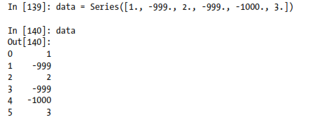
Replacing Values
Lets consider the series

Slide 19
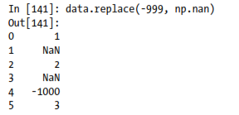
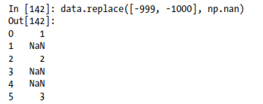
Replacing Values

Slide 20
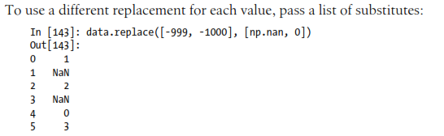
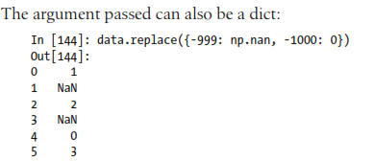
Replacing Values

Slide 21
Discretization and Binning
Continuous data is often discretized or otherwised separated into “bins” for analysis.
Suppose you have data about a group of people in a study, and you want to group them into discrete age buckets:
Let’s divide these into bins of 18 to 25, 26 to 35, 35 to 60, and finally 60 and older. To do so, you have to use cut, a function in pandas.

Slide 22
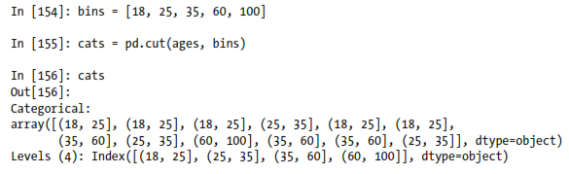
Discretization and Binning
Let’s divide these into bins of 18 to 25, 26 to 35, 35 to 60, and finally 60 and older. To do so, you have to use cut, a function in pandas.

Slide 23
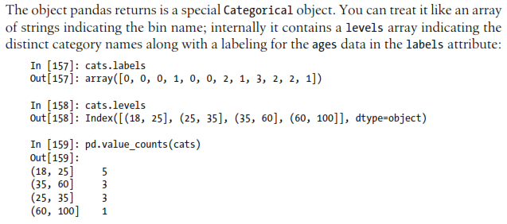
Discretization and Binning

Slide 24
Discretization and Binning

Slide 25
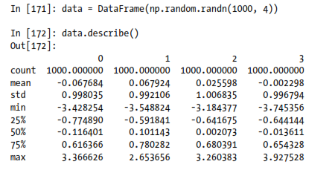
Detecting and Filtering Outliers
Filtering or transforming outliers is largely a matter of applying array operations. Consider a DataFrame with some normally distributed data:

Slide 26
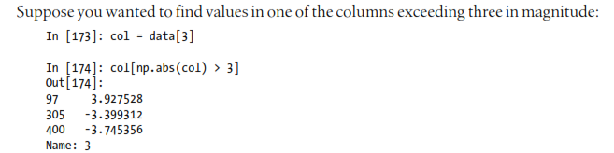
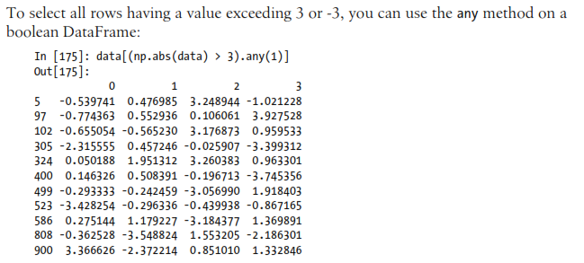
Detecting and Filtering Outliers

